Slide 1
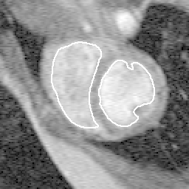
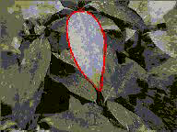
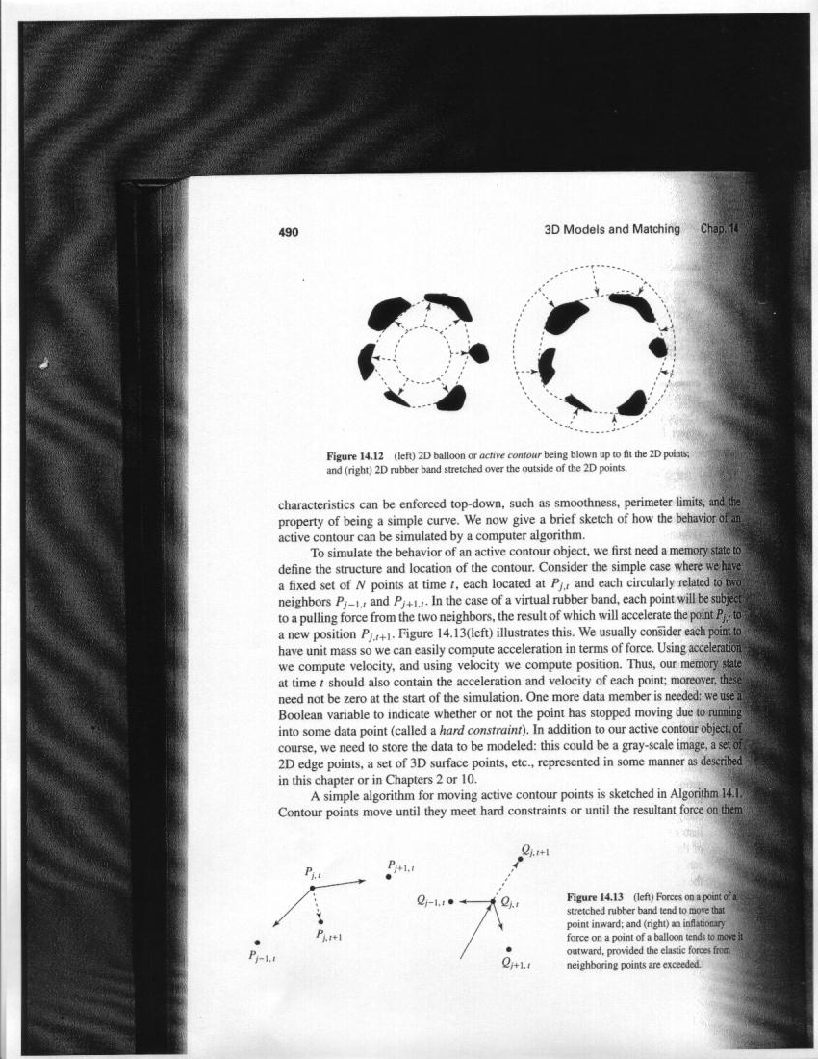
Fitting: Deformable contours
Devi Parikh
Georgia Tech
Disclaimer: Many slides have been borrowed from Kristen Grauman, who may have borrowed some of them from others. Any time a slide did not already have a credit on it, I have credited it to Kristen. So there is a chance some of these credits are inaccurate.
Slide credit: Kristen Grauman

Slide 2
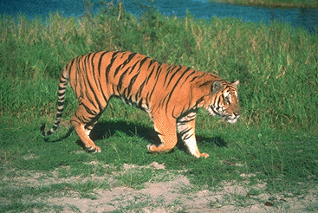
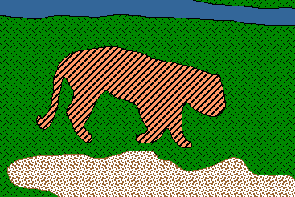
Recap so far: Grouping and Fitting
Goal: move from array of pixel values (or filter outputs) to a collection of regions, objects, and shapes.
Slide credit: Kristen Grauman

Slide 3
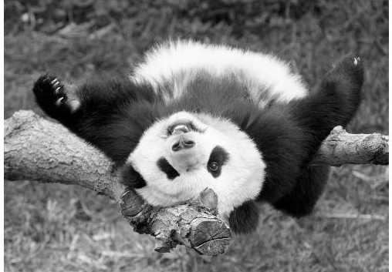
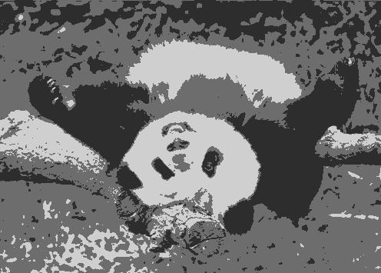
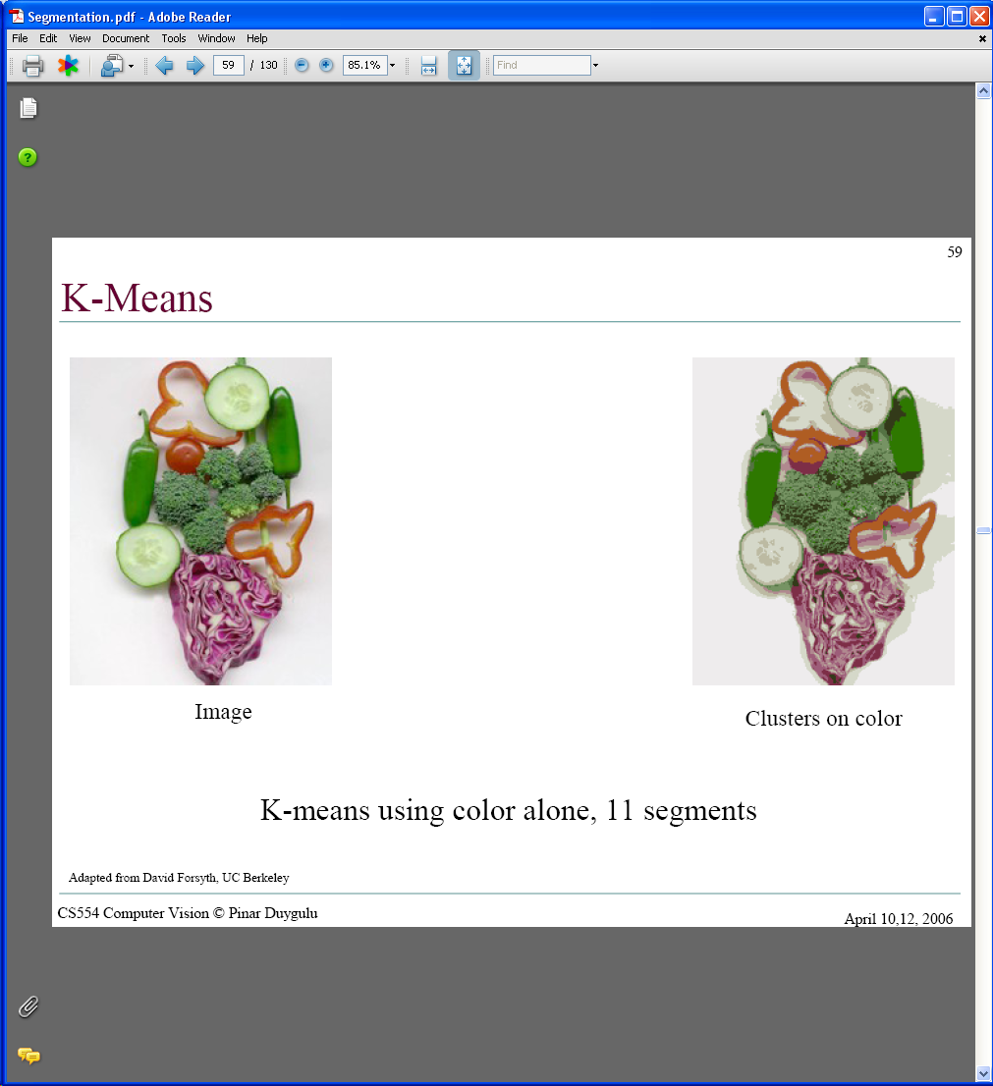
Grouping: Pixels vs. regions
By grouping pixels based on Gestalt-inspired attributes, we can map the pixels into a set of regions.
Each region is consistent according to the features and similarity metric we used to do the clustering.
image
clusters on intensity
image
clusters on color
Kristen Grauman

Slide 4
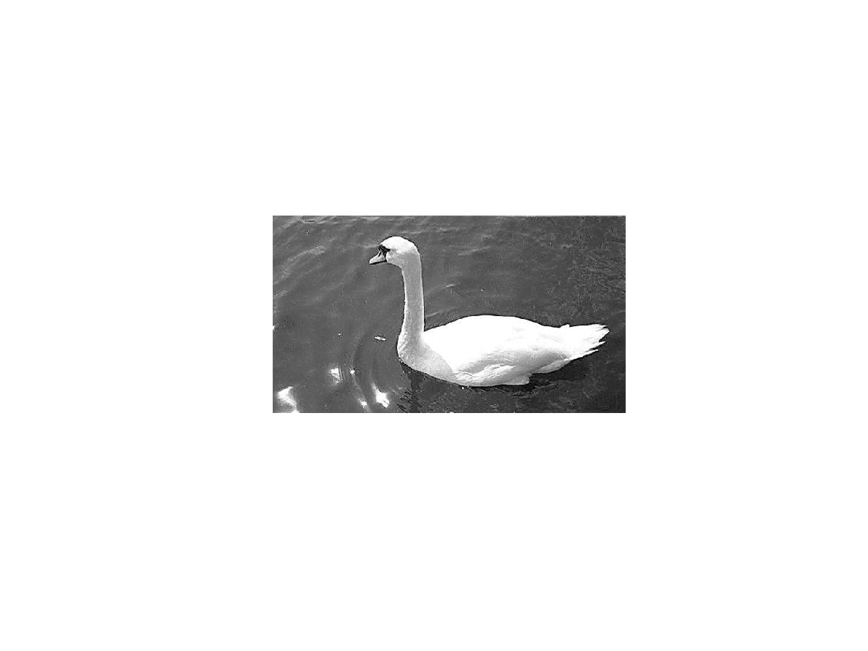
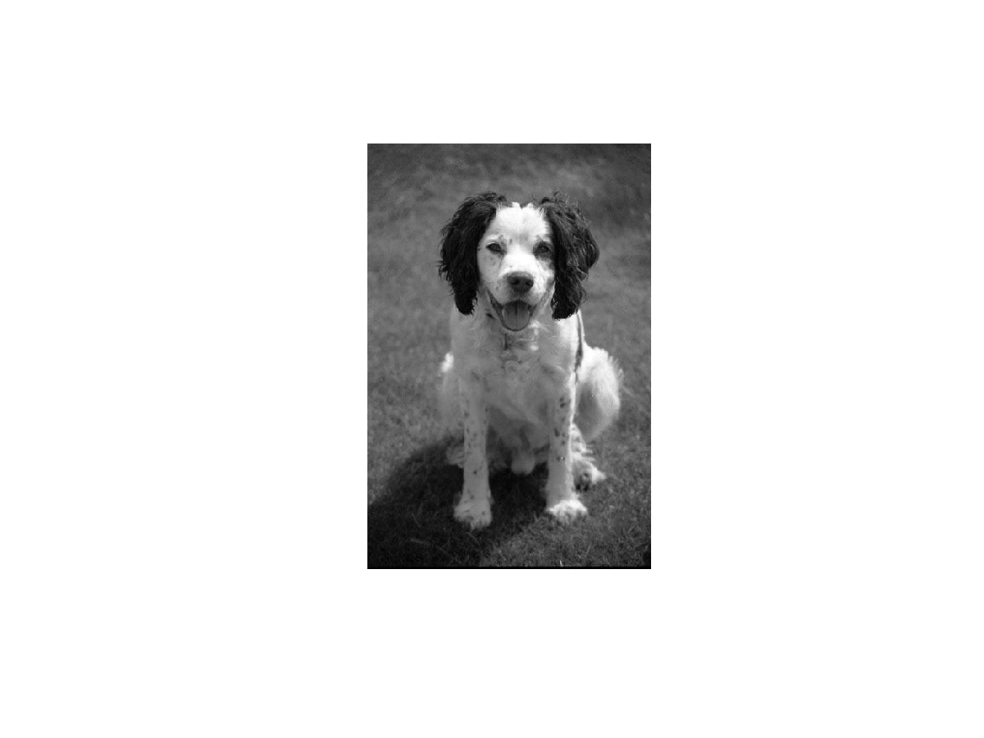
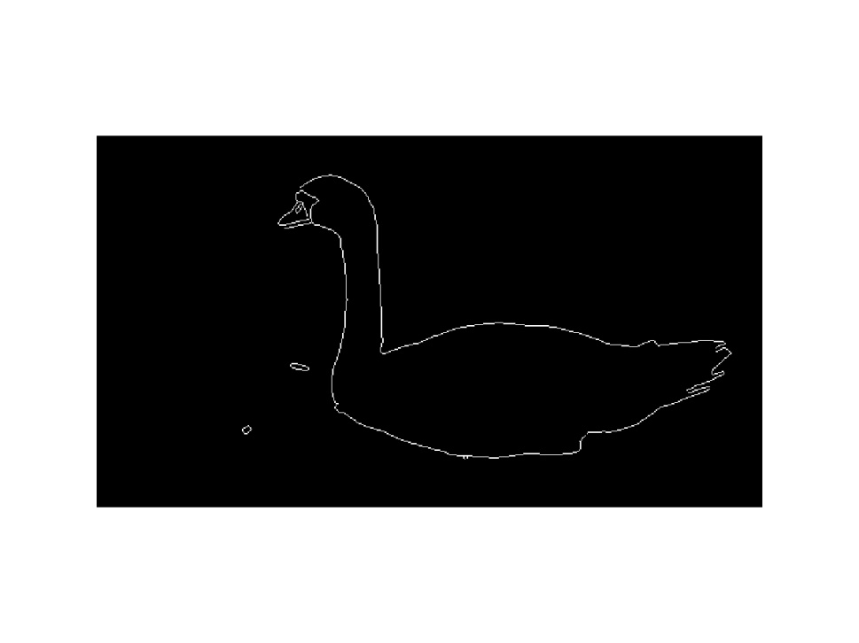
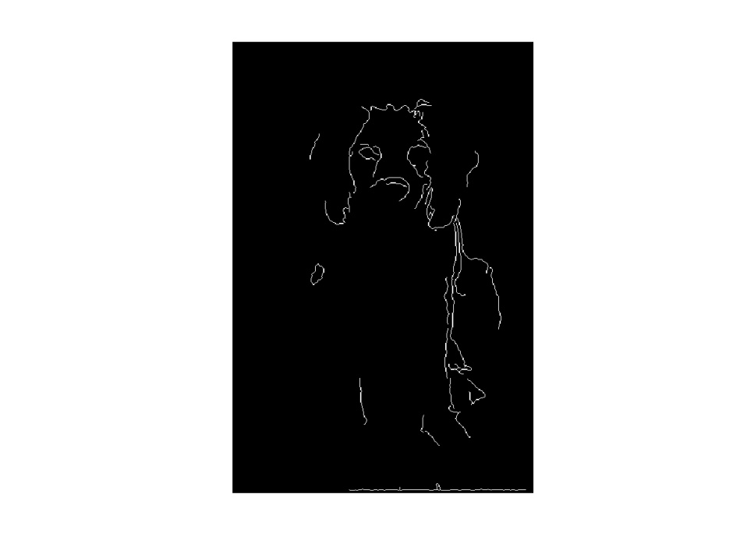
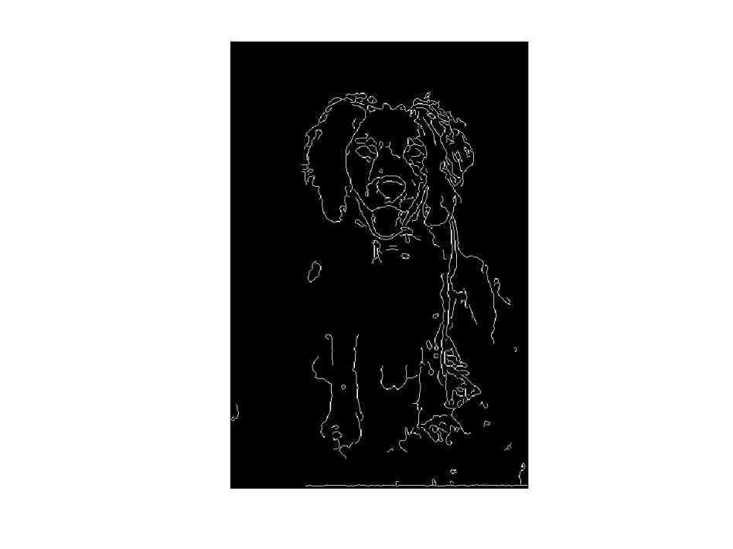
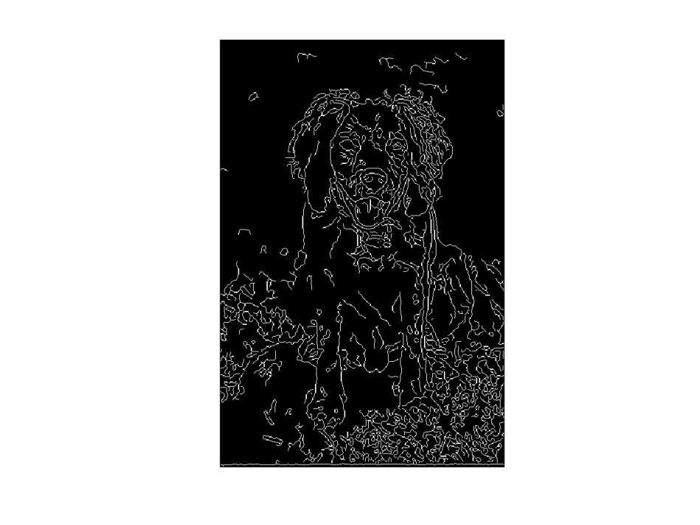
Fitting: Edges vs. boundaries
Edges useful signal to indicate occluding boundaries, shape.
Here the raw edge output is not so bad…
…but quite often boundaries of interest are fragmented, and we have extra “clutter” edge points.
Images from D. Jacobs
Kristen Grauman

Slide 5
Announcements
PS3
Due October 24th
Midterm / first update
Due October 31st
Slide credit: Adapted by Devi Parikh from Kristen Grauman

Slide 6
Topics overview
Intro
Multiple views and motion
Features & filters
Grouping & fitting
Segmentation and clustering
Hough transform
Deformable contours
Alignment and 2D image transformations
Recognition
Video processing
Slide credit: Kristen Grauman

Slide 7
Summary
Grouping/segmentation useful to make a compact representation and merge similar features
associate features based on defined similarity measure and clustering objective
Fitting problems require finding any supporting evidence for a model, even within clutter and missing features.
associate features with an explicit model
Voting approaches, such as the Hough transform, make it possible to find likely model parameters without searching all combinations of features.
Hough transform approach for lines, circles, …, arbitrary shapes defined by a set of boundary points, recognition from patches.
Kristen Grauman

Slide 8
Topics overview
Intro
Multiple views and motion
Features & filters
Grouping & fitting
Segmentation and clustering
Hough transform
Deformable contours
Recognition
Video processing
Slide credit: Kristen Grauman

Slide 9
Topics overview
Intro
Multiple views and motion
Features & filters
Grouping & fitting
Segmentation and clustering
Hough transform
Deformable contours
Recognition
Video processing
Slide credit: Kristen Grauman

Slide 10
Today
Fitting an arbitrary shape with “active” deformable contours
Slide credit: Kristen Grauman

Slide 11
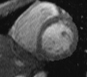
Deformable contours
a.k.a. active contours, snakes
Given: initial contour (model) near desired object
Slide credit: Kristen Grauman
[Snakes: Active contour models, Kass, Witkin, & Terzopoulos, ICCV1987]
Figure credit: Yuri Boykov

Slide 12
Deformable contours
a.k.a. active contours, snakes
Given: initial contour (model) near desired object
Goal: evolve the contour to fit exact object boundary
Main idea: elastic band is iteratively adjusted so as to
be near image positions with high gradients, and
satisfy shape “preferences” or contour priors
Slide credit: Kristen Grauman
[Snakes: Active contour models, Kass, Witkin, & Terzopoulos, ICCV1987]
Figure credit: Yuri Boykov

Slide 13
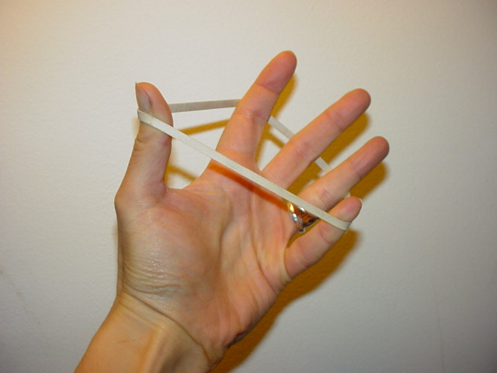
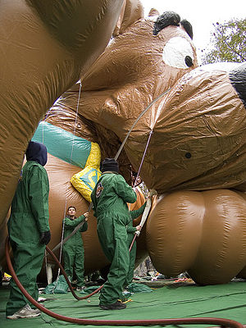
Deformable contours: intuition
Image from http://www.healthline.com/blogs/exercise_fitness/uploaded_images/HandBand2-795868.JPG
Kristen Grauman

Slide 14
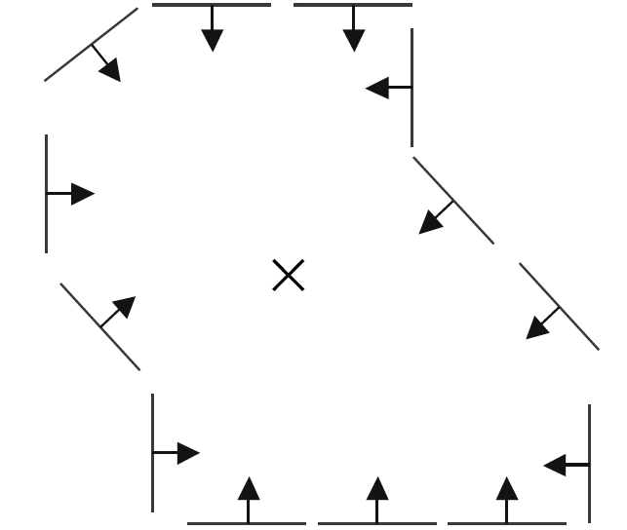
Deformable contours vs. Hough
Like generalized Hough transform, useful for shape fitting; but
initial
intermediate
final
Hough
Rigid model shape
Single voting pass can detect multiple instances
Deformable contours
Prior on shape types, but shape iteratively adjusted (deforms)
Requires initialization nearby
One optimization “pass” to fit a single contour
Kristen Grauman

Slide 15
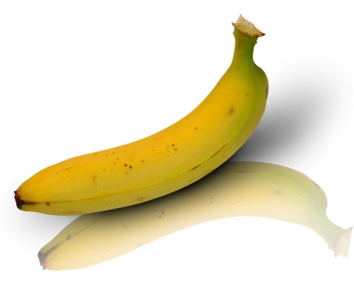
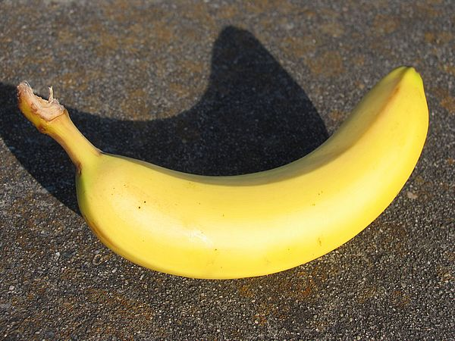
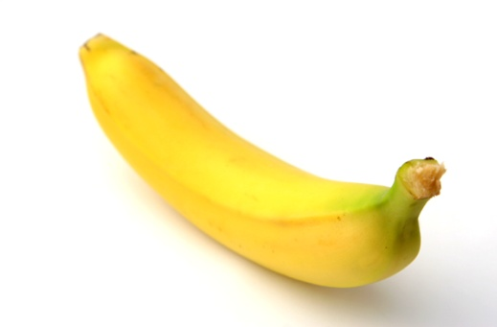
Why do we want to fit deformable shapes?
Some objects have similar basic form but some variety in the contour shape.
Kristen Grauman

Slide 16
Why do we want to fit deformable shapes?
Non-rigid, deformable objects can change their shape over time, e.g. lips, hands…
Figure from Kass et al. 1987
Kristen Grauman

Slide 17
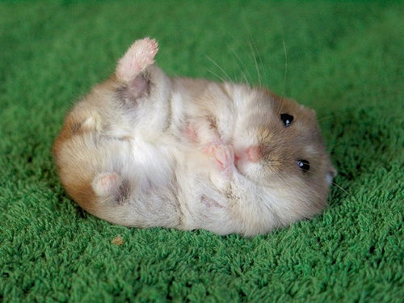
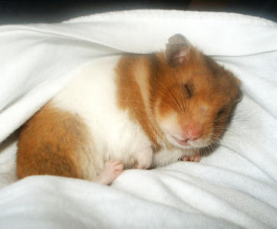
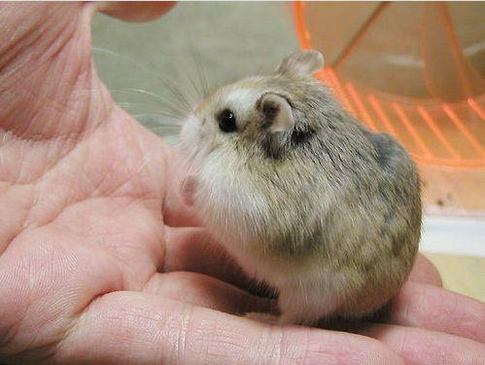
Why do we want to fit deformable shapes?
Non-rigid, deformable objects can change their shape over time, e.g. lips, hands…
Kristen Grauman

Slide 18
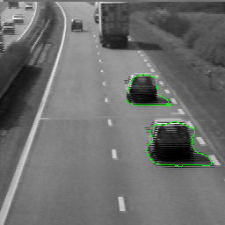
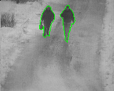
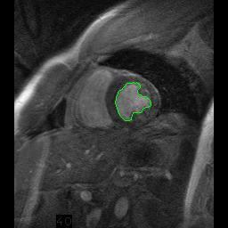
Why do we want to fit deformable shapes?
Non-rigid, deformable objects can change their shape over time.
Figure credit: Julien Jomier
Kristen Grauman

Slide 19
Aspects we need to consider
Representation of the contours
Defining the energy functions
External
Internal
Minimizing the energy function
Extensions:
Tracking
Interactive segmentation
Kristen Grauman

Slide 20
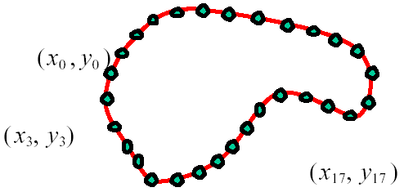
Representation
We’ll consider a discrete representation of the contour, consisting of a list of 2d point positions (“vertices”).
for
At each iteration, we’ll have the option to move each vertex to another nearby location (“state”).
Kristen Grauman

Slide 21
Fitting deformable contours
How should we adjust the current contour to form the new contour at each iteration?
Define a cost function (“energy” function) that says how good a candidate configuration is.
Seek next configuration that minimizes that cost function.
initial
intermediate
final
Slide credit: Kristen Grauman

Slide 22
Energy function
The total energy (cost) of the current snake is defined as:
Internal energy: encourage prior shape preferences: e.g., smoothness, elasticity, particular known shape.
External energy (“image” energy): encourage contour to fit on places where image structures exist, e.g., edges.
A good fit between the current deformable contour and the target shape in the image will yield a low value for this cost function.
Slide credit: Kristen Grauman

Slide 23
External energy: intuition
Measure how well the curve matches the image data
“Attract” the curve toward different image features
Edges, lines, texture gradient, etc.
Slide credit: Kristen Grauman

Slide 24

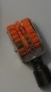
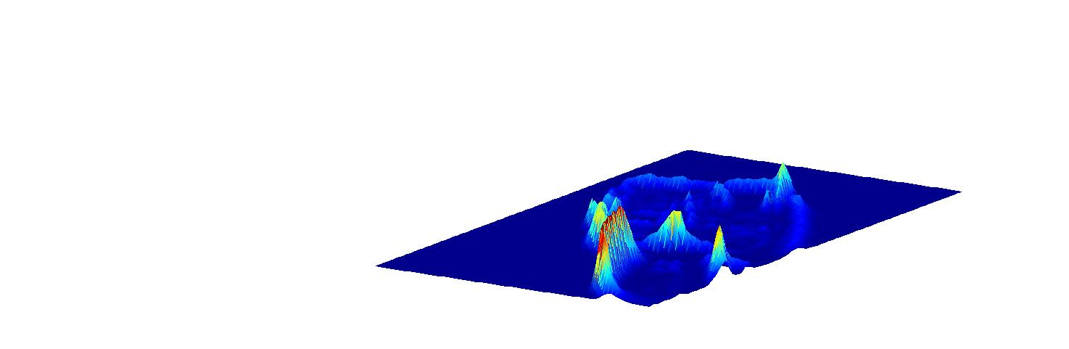
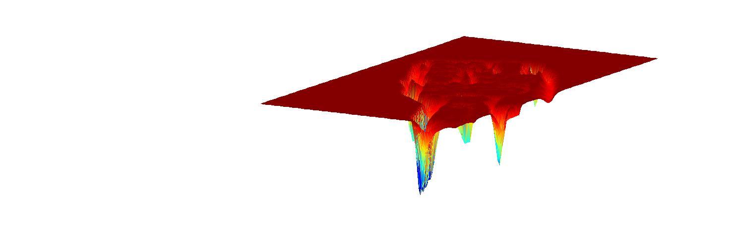
External image energy
How do edges affect “snap” of rubber band?
Think of external energy from image as gravitational pull towards areas of high contrast
Magnitude of gradient
- (Magnitude of gradient)
Slide credit: Kristen Grauman

Slide 25
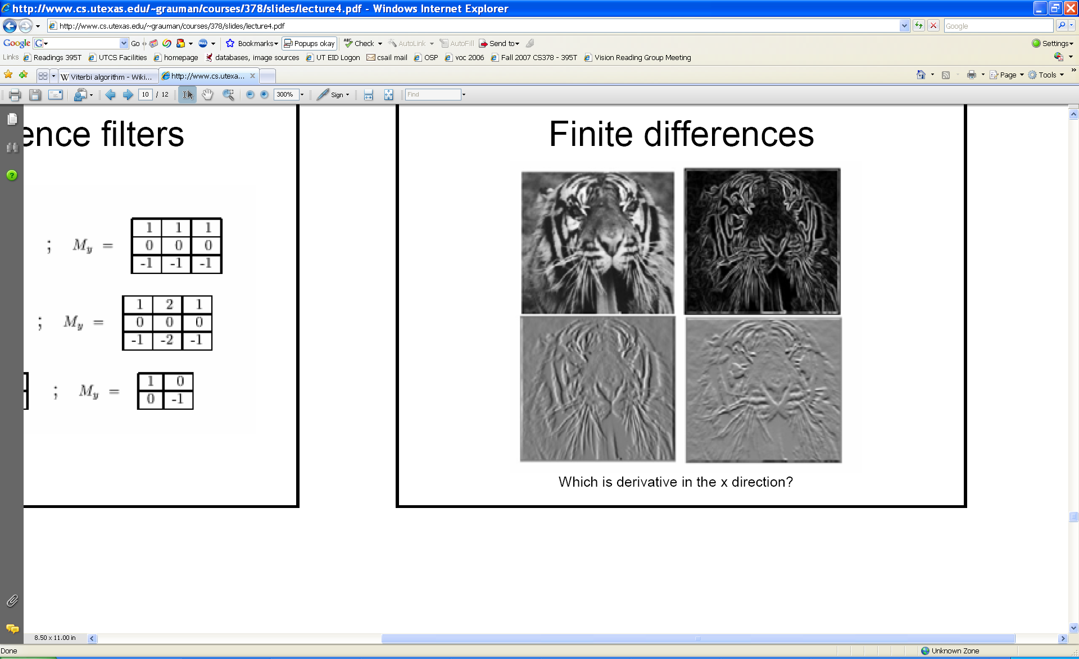
External image energy
Gradient images and
External energy at a point on the curve is:
External energy for the whole curve:
Kristen Grauman

Slide 26

Internal energy: intuition
What are the underlying boundaries in this fragmented edge image?
And in this one?
Kristen Grauman

Slide 27
Internal energy: intuition
A priori, we want to favor smooth shapes, contours with low curvature, contours similar to a known shape, etc. to balance what is actually observed (i.e., in the gradient image).
Kristen Grauman

Slide 28

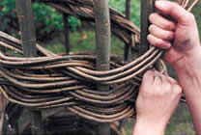
Internal energy
For a continuous curve, a common internal energy term is the “bending energy”.
At some point v(s) on the curve, this is:
Tension,
Elasticity
Stiffness,
Curvature
Kristen Grauman

Slide 29
Internal energy
For our discrete representation,
Internal energy for the whole curve:
…
Note these are derivatives relative to position---not spatial image gradients.
Why do these reflect tension and curvature?
Kristen Grauman

Slide 30
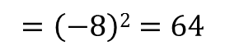
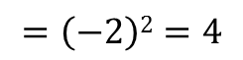
Example: compare curvature
(2,5)
(2,2)
(3,1)
(1,1)
(3,1)
(1,1)
$$\left(3−2\left(2\right)+1\right)2+\left(1−2\left(5\right)+1\right)2$$
$$\left(3−2\left(2\right)+1\right)2+\left(1−2\left(2\right)+1\right)2$$
$$=\left(−8\right)2=64$$
$$=\left(−2\right)2=4$$
Kristen Grauman

Slide 31
Penalizing elasticity
Current elastic energy definition uses a discrete estimate of the derivative:
What is the possible problem with this definition?
Kristen Grauman

Slide 32
Penalizing elasticity
Current elastic energy definition uses a discrete estimate of the derivative:
Instead:
where d is the average distance between pairs of points – updated at each iteration.
Kristen Grauman

Slide 33
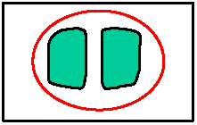
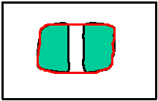
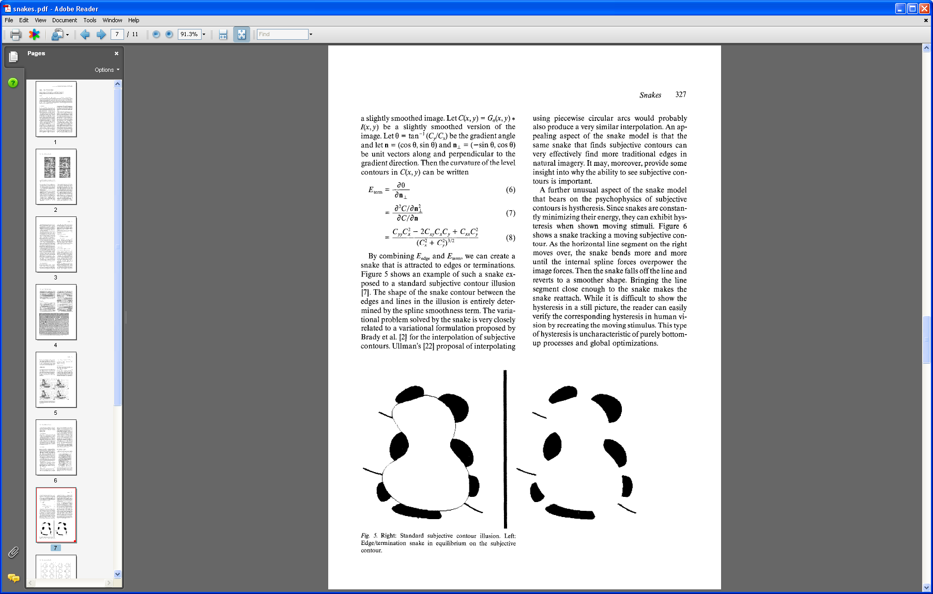
Dealing with missing data
The preferences for low-curvature, smoothness help deal with missing data:
Illusory contours found!
[Figure from Kass et al. 1987]
Slide credit: Kristen Grauman

Slide 34
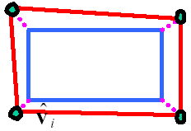
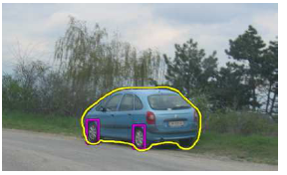
Extending the internal energy: capture shape prior
If object is some smooth variation on a known shape, we can use a term that will penalize deviation from that shape:
where are the points of the known shape.
Slide credit: Kristen Grauman
Fig from Y. Boykov

Slide 35
Total energy: function of the weights
Slide credit: Kristen Grauman

Slide 36
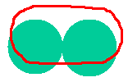


Total energy: function of the weights
e.g., weight controls the penalty for internal elasticity
large
medium
small
Slide credit: Kristen Grauman
Fig from Y. Boykov

Slide 37
Recap: deformable contour
A simple elastic snake is defined by:
A set of n points,
An internal energy term (tension, bending, plus optional shape prior)
An external energy term (gradient-based)
To use to segment an object:
Initialize in the vicinity of the object
Modify the points to minimize the total energy
Kristen Grauman

Slide 38
Energy minimization
Several algorithms have been proposed to fit deformable contours.
We’ll look at two:
Greedy search
Dynamic programming (for 2d snakes)
Slide credit: Kristen Grauman

Slide 39
Energy minimization: greedy
For each point, search window around it and move to where energy function is minimal
Typical window size, e.g., 5 x 5 pixels
Stop when predefined number of points have not changed in last iteration, or after max number of iterations
Note:
Convergence not guaranteed
Need decent initialization
Kristen Grauman

Slide 40
Energy minimization
Several algorithms have been proposed to fit deformable contours.
We’ll look at two:
Greedy search
Dynamic programming (for 2d snakes)
Slide credit: Kristen Grauman

Slide 41
Energy minimization: dynamic programming
With this form of the energy function, we can minimize using dynamic programming, with the Viterbi algorithm.
Iterate until optimal position for each point is the center of the box, i.e., the snake is optimal in the local search space constrained by boxes.
Fig from Y. Boykov
Slide credit: Kristen Grauman
[Amini, Weymouth, Jain, 1990]

Slide 42
Energy minimization: dynamic programming
Possible because snake energy can be rewritten as a sum of pair-wise interaction potentials:
Or sum of triple-interaction potentials.
Slide credit: Kristen Grauman

Slide 43
Snake energy: pair-wise interactions
Re-writing the above with :
where
Kristen Grauman

Slide 44
Viterbi algorithm
Main idea: determine optimal position (state) of predecessor, for each possible position of self. Then backtrack from best state for last vertex.
vertices
states
1
2
…
m
Complexity:
vs. brute force search ____?
Slide credit: Kristen Grauman
Example adapted from Y. Boykov

Slide 45
Energy minimization: dynamic programming
With this form of the energy function, we can minimize using dynamic programming, with the Viterbi algorithm.
Iterate until optimal position for each point is the center of the box, i.e., the snake is optimal in the local search space constrained by boxes.
Fig from Y. Boykov
Slide credit: Kristen Grauman
[Amini, Weymouth, Jain, 1990]

Slide 46
Energy minimization: dynamic programming
DP can be applied to optimize an open ended snake
For a closed snake, a “loop” is introduced into the total energy.
Work around:
Fix v₁ and solve for rest .
Fix an intermediate node at its position found in (1), solve for rest.
Slide credit: Kristen Grauman

Slide 47
Aspects we need to consider
Representation of the contours
Defining the energy functions
External
Internal
Minimizing the energy function
Extensions:
Tracking
Interactive segmentation
Slide credit: Kristen Grauman

Slide 48
Tracking via deformable contours
Use final contour/model extracted at frame t as an initial solution for frame t+1
Evolve initial contour to fit exact object boundary at frame t+1
Repeat, initializing with most recent frame.
Tracking Heart Ventricles
(multiple frames)
Kristen Grauman

Slide 49
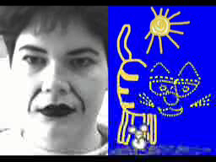
Tracking via deformable contours
Visual Dynamics Group, Dept. Engineering Science, University of Oxford.
Applications:
Traffic monitoring
Human-computer interaction
Animation
Surveillance
Computer assisted diagnosis in medical imaging
Kristen Grauman
Notes:
http://www.robots.ox.ac.uk/~vdg/dynamics.html

Slide 50
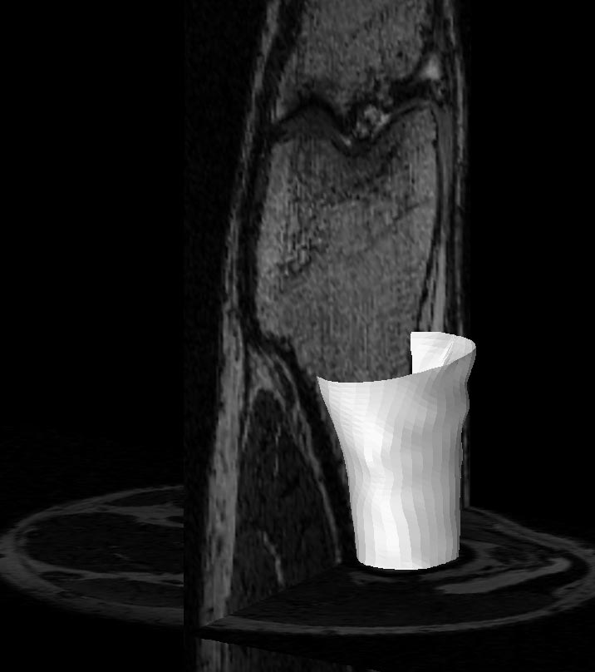
3D active contours
Jörgen Ahlberg
http://www.cvl.isy.liu.se/ScOut/Masters/Papers/Ex1708.pdf
Kristen Grauman

Slide 51
Limitations
May over-smooth the boundary
Cannot follow topological changes of objects
Slide credit: Kristen Grauman

Slide 52
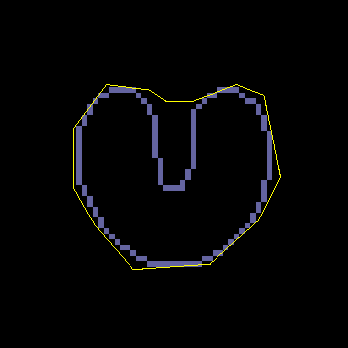
Limitations
External energy: snake does not really “see” object boundaries in the image unless it gets very close to it.
image gradients
are large only directly on the boundary
Slide credit: Kristen Grauman

Slide 53


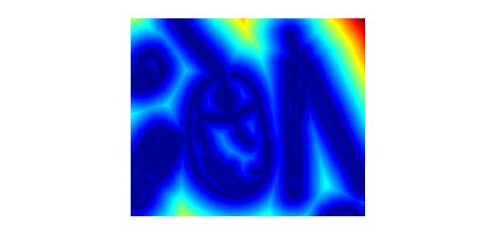

Distance transform
External image can instead be taken from the distance transform of the edge image.
original
-gradient
distance transform
Value at (x,y) tells how far that position is from the nearest edge point (or other binary mage structure)
>> help bwdist
edges
Kristen Grauman

Slide 54
Deformable contours: pros and cons
Pros:
Useful to track and fit non-rigid shapes
Contour remains connected
Possible to fill in “subjective” contours
Flexibility in how energy function is defined, weighted.
Cons:
Must have decent initialization near true boundary, may get stuck in local minimum
Parameters of energy function must be set well based on prior information
Kristen Grauman

Slide 55
Summary
Deformable shapes and active contours are useful for
Segmentation: fit or “snap” to boundary in image
Tracking: previous frame’s estimate serves to initialize the next
Fitting active contours:
Define terms to encourage certain shapes, smoothness, low curvature, push/pulls, …
Use weights to control relative influence of each component cost
Can optimize 2d snakes with Viterbi algorithm.
Image structure (esp. gradients) can act as attraction force for interactive segmentation methods.
Kristen Grauman

Slide 56

Interactive forces
How can we implement such an interactive force with deformable contours?
Kristen Grauman

Slide 57
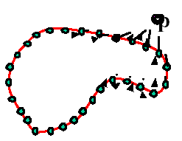
Interactive forces
An energy function can be altered online based on user input – use the cursor to push or pull the initial snake away from a point.
Modify external energy term to include a term such that
Nearby points get pushed hardest
Adapted by Devi Parikh from Kristen Grauman

Slide 58
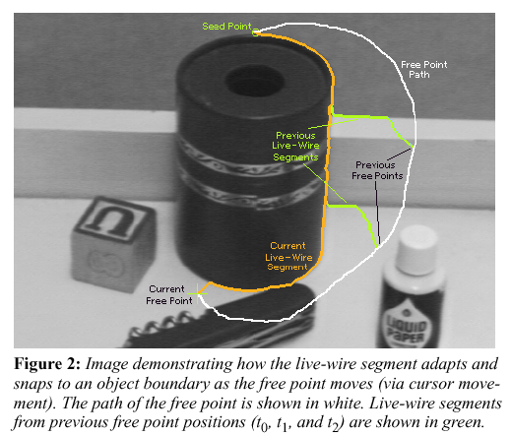
Intelligent scissors
Another form of interactive segmentation:
Compute optimal paths from every point to the seed based on edge-related costs.
[Mortensen & Barrett, SIGGRAPH 1995, CVPR 1999]
Adapted by Devi Parikh from Kristen Grauman
Demo: http://www.luberth.com/java/scissors/

Slide 59
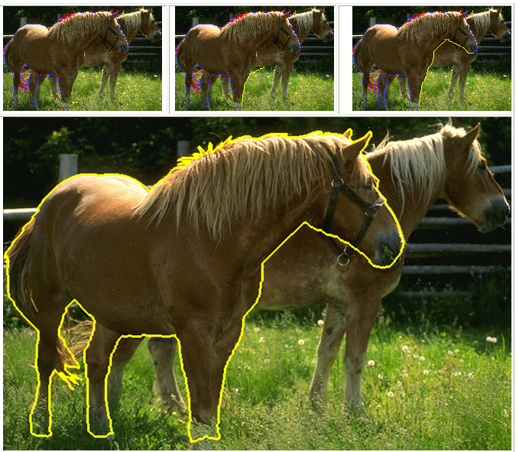
Intelligent scissors
http://rivit.cs.byu.edu/Eric/Eric.html
Slide credit: Kristen Grauman

Slide 60
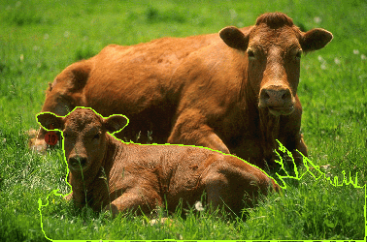
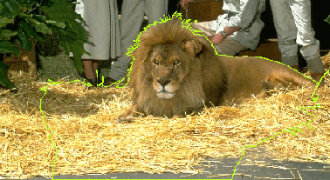


Intelligent scissors
http://rivit.cs.byu.edu/Eric/Eric.html
Slide credit: Kristen Grauman

Slide 61


Beyond boundary snapping…
Another form of interactive guidance: specify regions
Usually taken to suggest foreground/background color distributions
User Input
Result
How to use this information?
Boykov and Jolly (2001)
Kristen Grauman

Slide 62

Recall: Images as graphs
q
w_{pq}
w
p
Fully-connected graph
node for every pixel
link between every pair of pixels, p,q
similarity w_{pq} for each link
similarity is inversely proportional to difference in color and position
Steve Seitz

Slide 63
Recall: Segmentation by Graph Cuts
w
A
B
C
Break graph into segments
Delete links that cross between segments
Easiest to break links that have low similarity
similar pixels should be in the same segments
dissimilar pixels should be in different segments
Steve Seitz

Slide 64
Recall: Segmentation by Graph Cuts
B
A
Link Cut
set of links whose removal makes a graph disconnected
cost of a cut:
Find minimum cut
gives you a segmentation
fast algorithms exist for doing this
Source: Steve Seitz

Slide 65


Graph cuts for interactive segmentation
Adding hard constraints:
Add two additional nodes, object and background “terminals”
Link each pixel
To both terminals
To its neighboring pixels
Yuri Boykov

Slide 66
Graph cuts for interactive segmentation
Adding hard constraints:
Let the edge weight to object or background terminal reflect similarity to the respective seed pixels.
Yuri Boykov

Slide 67


Graph cuts for interactive segmentation
Boykov and Jolly (2001)
Yuri Boykov

Slide 68




Graph cuts for interactive segmentation
Another interaction modality: specify bounding box
Intelligent Scissors Mortensen and Barrett (1995)
Graph Cuts Boykov and Jolly (2001)
GrabCut Rother et al. (2004)
Slide credit: Kristen Grauman

Slide 69


“Grab Cut”
Loosely specify foreground region
Iterated graph cut
?
User Initialisation
User initialization
Graph cuts to infer the segmentation
K-means for learning colour distributions
Rother et al (2004)

Slide 70



“Grab Cut”
Loosely specify foreground region
Iterated graph cut
R
R
Foreground & Background
Iterated graph cut
Foreground
Background
G
Background
G
Gaussian Mixture Model (typically 5-8 components)
Rother et al (2004)

Slide 71








“Grab Cut”
Rother et al (2004)

Slide 72
Topics overview
Intro
Multiple views and motion
Features & filters
Grouping & fitting
Segmentation and clustering
Hough transform
Deformable contours
Recognition
Video processing
Slide credit: Kristen Grauman

Slide 73
Questions?
Slide credit: Devi Parikh

